Slide 1
Unfair Dragon King

Slide 2
Introduction
Games have become an important part of our culture in a relatively short period of time. The industry is also developing into a major pillar of many modern economies, with game development tax schemes being introduced into many developed countries. These are coinciding with a period of time where it has never been easier to make and release a game into the commercial market. For the last two decades, game development teams have required financial backing and a level of expertise to pass stringent tests by platform holders to be allowed access to their development hardware. Today, anyone with a mobile phone or a tablet and a computer, even a laptop, can build a game and have it for sale with a minimum of time and financial backing. This does not mean that every game is successful: it is still essential to have a good understanding of the technical aspects involved in making games and the considerations involved in designing games which people will want to play. Sometimes the best way to develop this knowledge is to begin at the very beginning, so we'll look at some game history.

Slide 3
Description of the Project
UNFAIR DRAGON KING is a 2D Visual game where you have to collect the apples or banana and the difficulty level increases as you go further. The ultimate goal is to collect the apples and reach the end point.
It is a different genre of game basically inspired by one of the most famous web game Unfair Mario.
Unfair Mario was launched around 9 years ago, so we thought about creating our own game of the same genre but with different Character and better In-game Graphics

Slide 4
Tools and Technologies used
Unity Game Engine
Adobe Illustrator
Visual Studio Community
C# Script

Slide 5
Unity Engine
Unity is a cross-platform game engine developed by Unity Technologies. This engine can be used to create Three-Dimensional (3D) and Two-Dimensional (2D) games, as well as interactive simulations.
We designed our Character, Maps and Obstacles on Adobe Illustrator and imported these assets on Unity engine to combine all these together to make the game working.
Movements and levels insertion was made easier using the C# script on the Unity.
Unity has an amazing Asset Store which we used to add the game sounds.

Slide 6
Adobe Illustrator
Adobe Illustrator is a vector graphics editor and design program developed and marketed by Adobe Inc.
On this Software, We designed our Main character, Game Backgrounds, and obstacles.
Importing these on the Unity engine was a bit difficult, but we made it work.

Slide 7
Visual Studio Community
Visual Studio brings a premium debugging experience to the Unity game engine. Issues are quickly identified by debugging your Unity games in Visual Studio.
It automatically gets connected to the unity engine for adding any script for the game development.
For 2d games development, VS Community slightly makes it easier because it has all the required functions for the same.

Slide 8
C# Script
Why we chose C# over any other language?
C# can be used to create almost anything but is particularly strong at building Windows desktop applications and games. And most importantly C# is widely-used to create games using the Unity game engine, which is the most popular game engine today.
The Working of all the movements & obstacles was made possible using this script in Unity Engine.

Slide 9
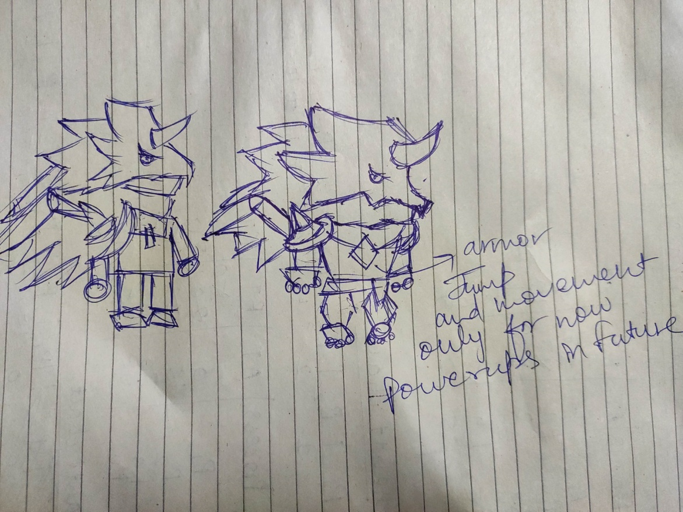
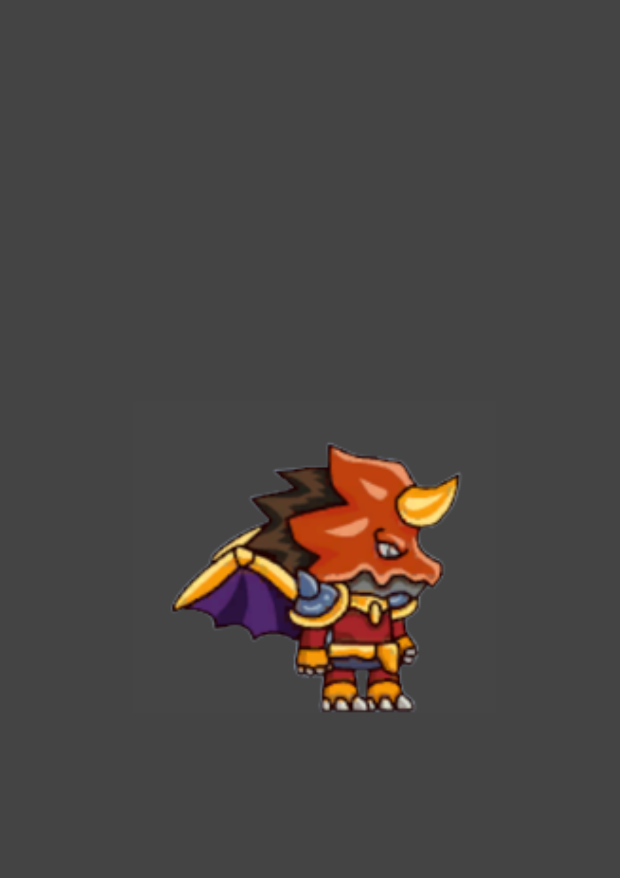
Project Design
Character Design- Dragon King

Slide 10
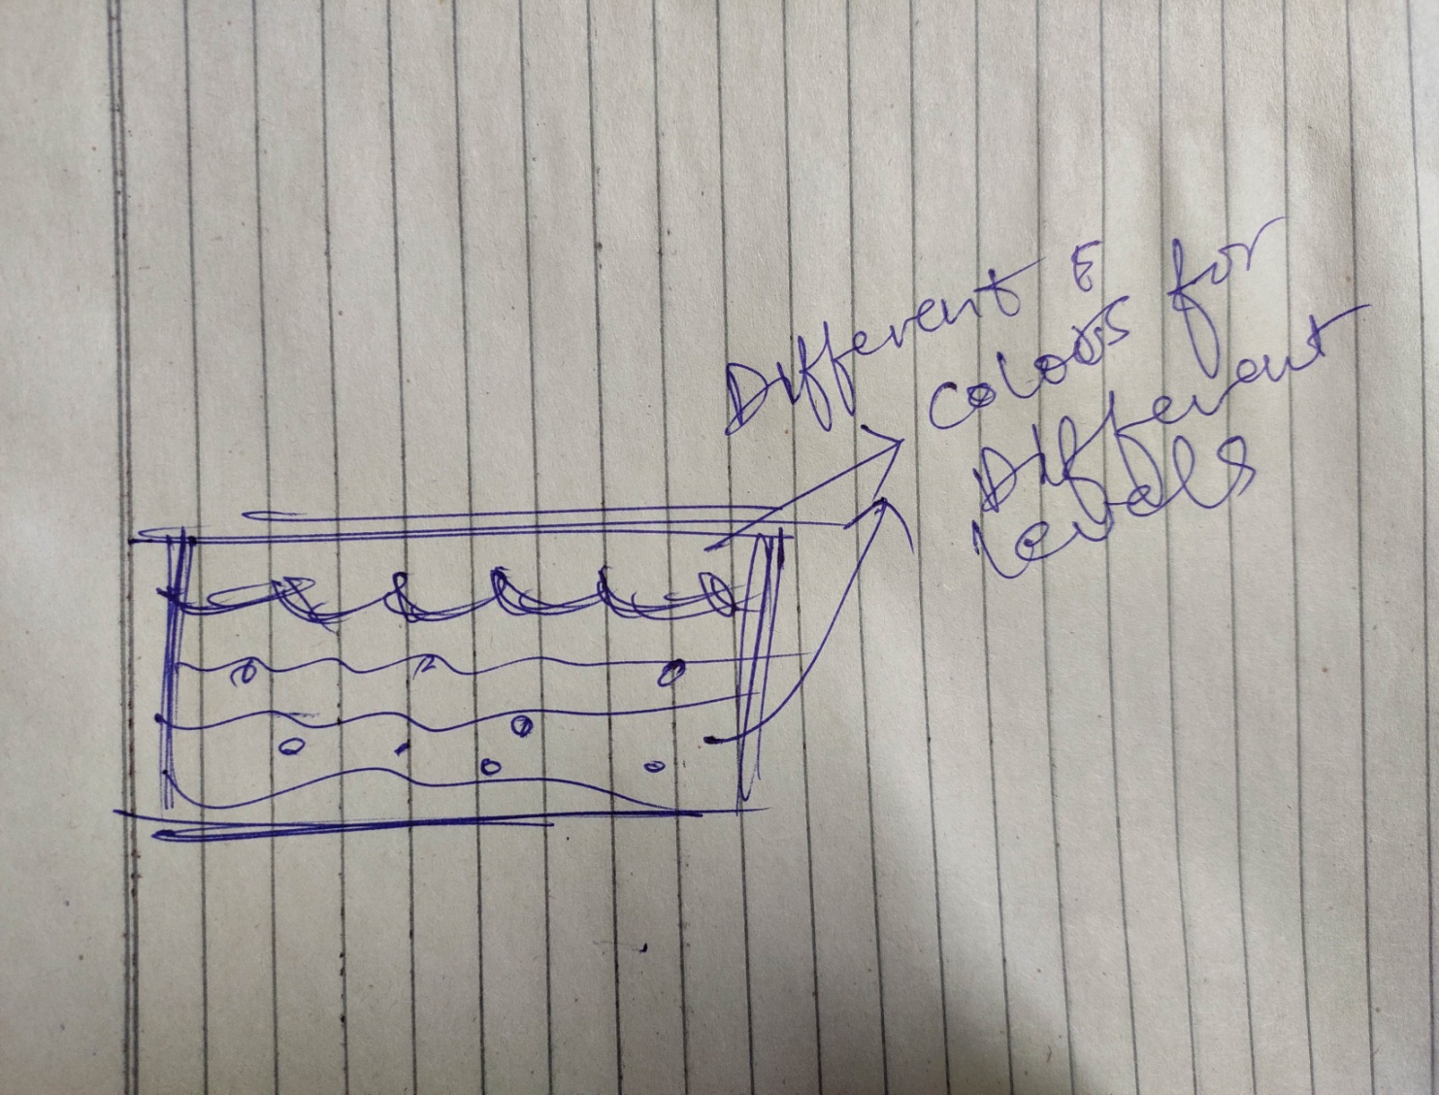
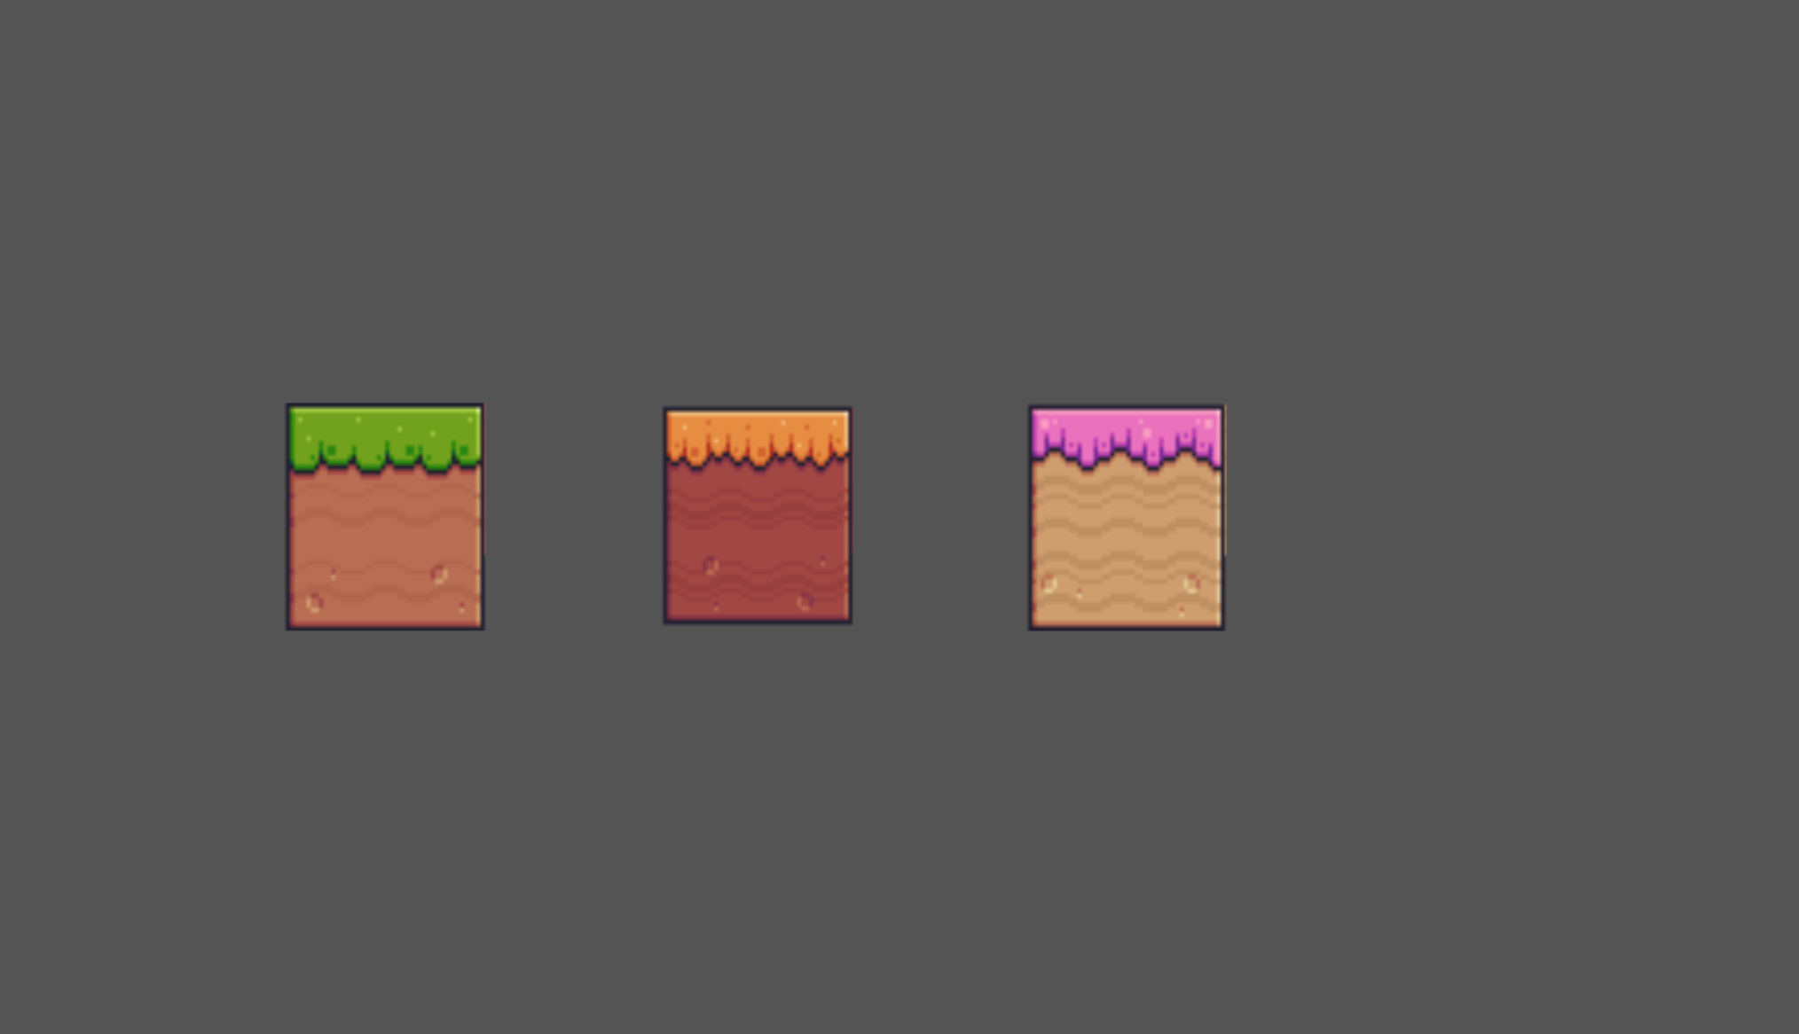
Map Design- Green, Red and Pink surface

Slide 11
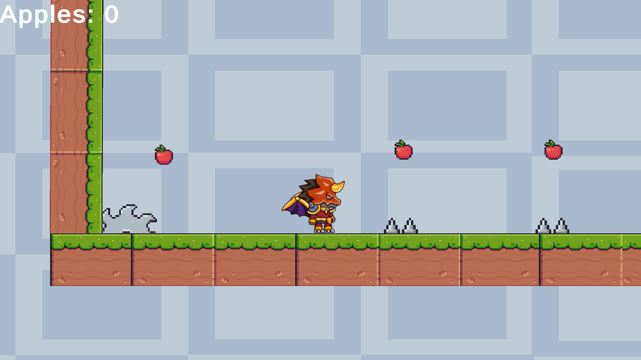
In-Game Snippet

Slide 12
System Requirements
Windows XP, Windows 7(ultimate, enterprise), 8, 10, 11
Processor – i3 and above
Hard Disk – 5 GB and above
Memory – 1 GB RAM and above
Unity and Other Game Files.

Slide 13
Results(steps to play the game)
Press Start button to start the game.
Use Left and Right Arrow keys to move left and right.
Use Spacebar to Jump.
And most important, beware of the obstacles that will come in the way.

Slide 14
Future Plans
Due to shortage of time, we weren’t able to add more characters and themes in the game, but we will definitely add more and more layers to it and will launch it soon also as an android game.
We have only worked on Front-end for now but are currently working on Back-end basically DATABASE for storing all the information of players. We have already made our database but we were not able to connect it to the unity server .

